Slide 1
Two seahorses robot carry a stick together stack to their wrapped tails
Raha Shabani- 1993609

Slide 2
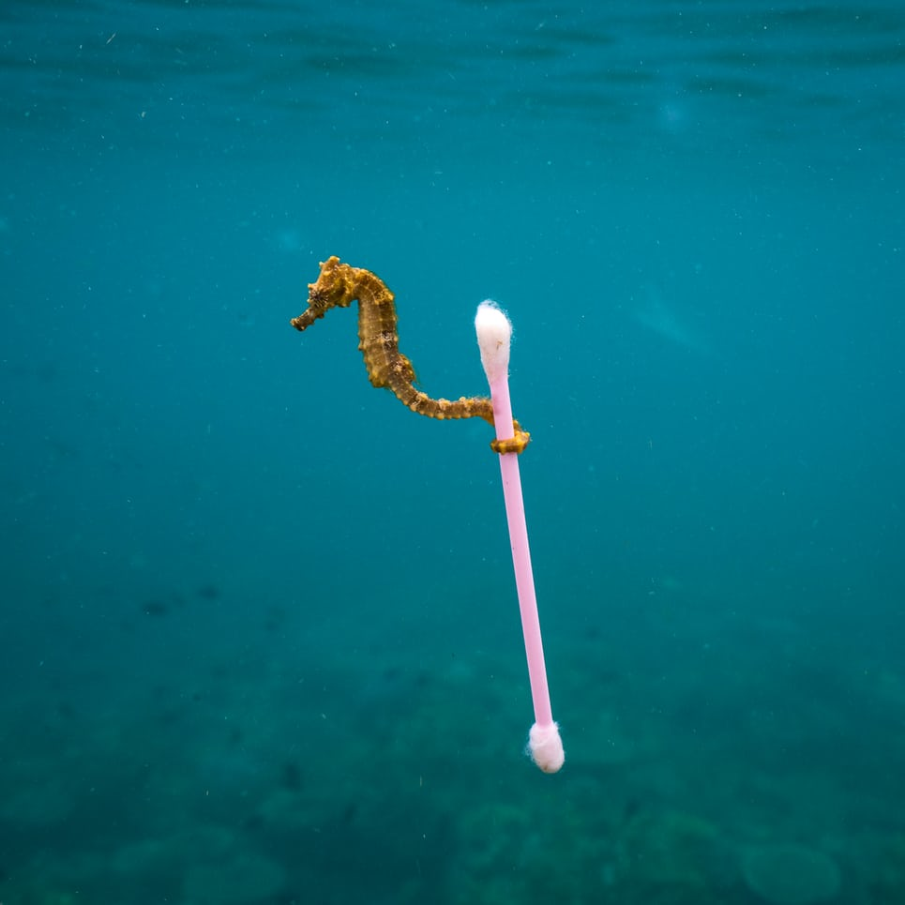
Two seahorses robot carry a stick together stack to their wrapped tails

Slide 3
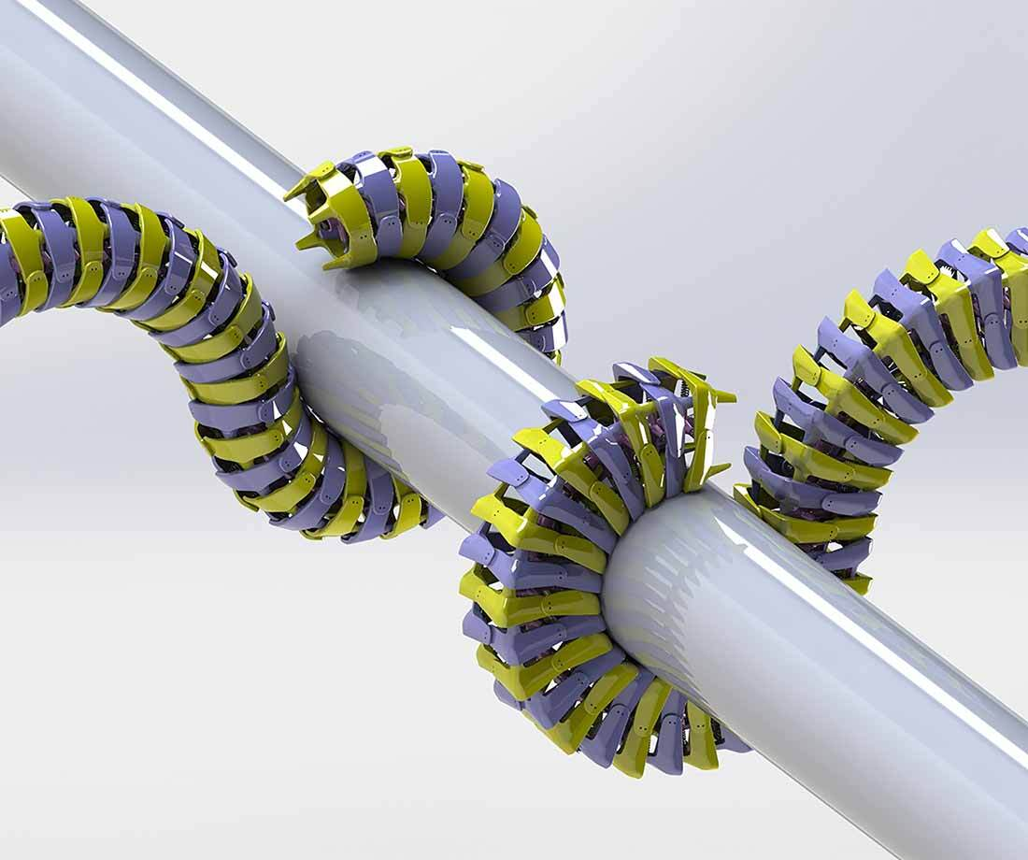
Purpose:

Slide 4
Seahorses particular interest:
Scientists believe in the design of bots
Strong
flexible enough to perform tasks in real-world settings.

Slide 5
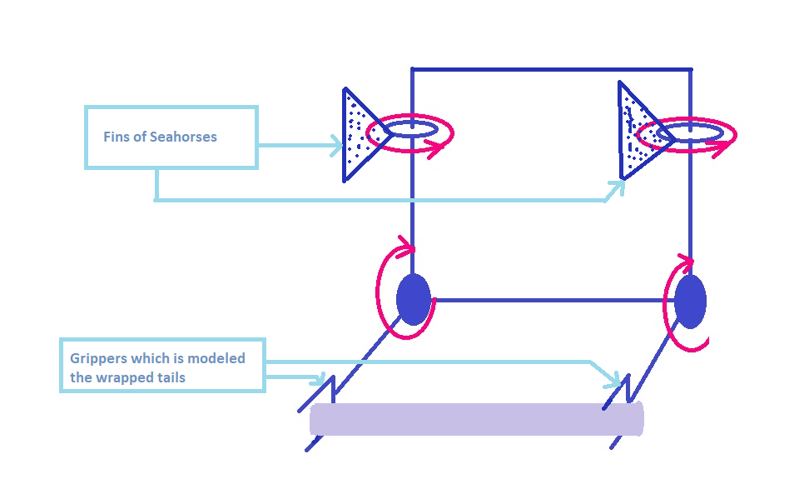
Sea horses kinematics

Slide 6
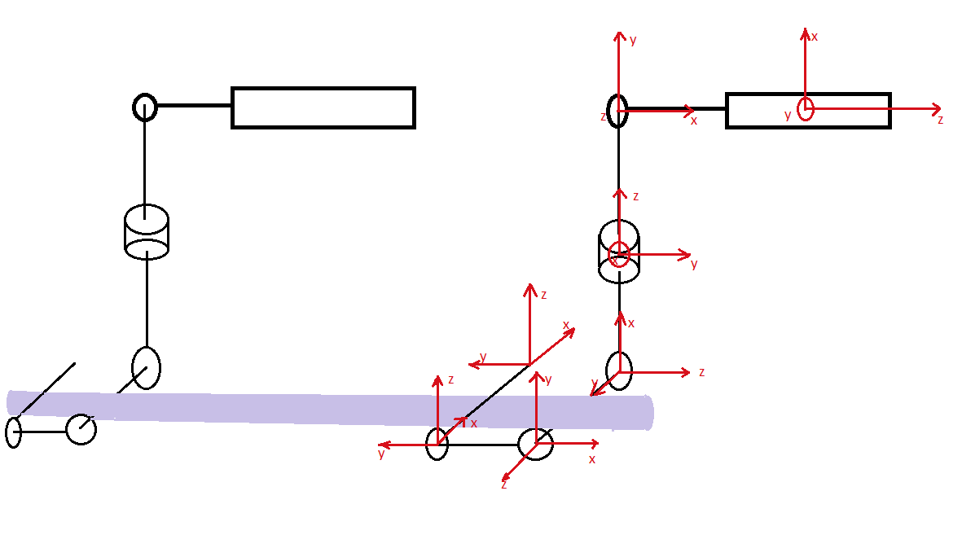
Sea horses kinematics

Slide 7
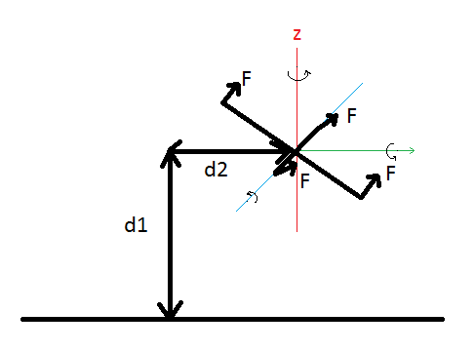
Kinematics:

Slide 8
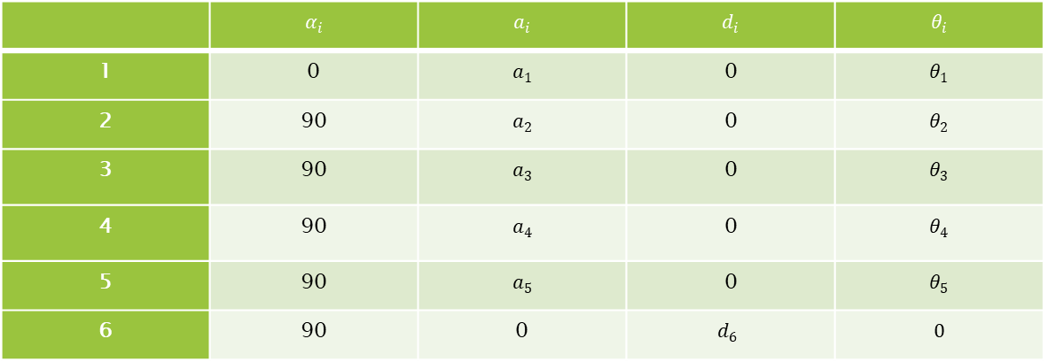

DH parameters
$q={\left(X,Θ\right)}^{T}where X={\left(x,y,z\right)}^{T}, Θ={\left(ψ,θ,ϕ\right)}^{T}$
 | $$α_{i}$$ | $$a_{i}$$ | $$d_{i}$$ | $$θ_{i}$$
1 | 0 | $$a_{1}$$ | 0 | $$θ_{1}$$
2 | 90 | $$a_{2}$$ | 0 | $$θ_{2}$$
3 | 90 | $$a_{3}$$ | 0 | $$θ_{3}$$
4 | 90 | $$a_{4}$$ | 0 | $$θ_{4}$$
5 | 90 | $$a_{5}$$ | 0 | $$θ_{5}$$
6 | 90 | 0 | $$d_{6}$$ | $$0$$

Slide 9
'R is Rotation Matrix'
[[sin(t5) #1 - cos(t5) #4, sin(90) #6 + cos(90) sin(t5) #4 + cos(90) cos(t5) #1,
cos(90) #6 - sin(90) sin(t5) #4 - sin(90) cos(t5) #1],
[cos(t5) #3 - sin(t5) #2, sin(90) #5 - cos(90) sin(t5) #3 - cos(90) cos(t5) #2,
cos(90) #5 + sin(90) sin(t5) #3 + sin(90) cos(t5) #2],
[cos(t5) #8 - sin(t5) #7, - sin(90) #9 - cos(90) sin(t5) #8 - cos(90) cos(t5) #7,
sin(90) sin(t5) #8 - cos(90) #9 + sin(90) cos(t5) #7]]

Slide 10
'd is translation Matrix'
[[a1 cos(t1) - d6 (sin(90) sin(t5) #6 - cos(90) (cos(90) #7 - sin(90) sin(t4) #14 + sin(90) cos(t4) #13) + sin(90) cos(t5) #1)
- a3 sin(t3) #19 + a3 cos(t3) #20 - a5 cos(t5) #6 + a2 cos(t1) cos(t2) - a4 cos(t4) #14 - a2 sin(t1) sin(t2) - a4
sin(t4) #13 + a5 sin(t5) #1],
[a1 sin(t1) + d6 (cos(90) (sin(90) sin(t4) #12 - cos(90) #8 + sin(90) cos(t4) #11) + sin(90) sin(t5) #5 + sin(90) cos(t5) #2)
+ a3 sin(t3) #16 + a3 cos(t3) #17 + a5 cos(t5) #5 + a4 cos(t4) #12 + a2 cos(t1) sin(t2) + a2 cos(t2) sin(t1) - a4
sin(t4) #11 - a5 sin(t5) #2],
2
[d6 (sin(90) sin(t5) #4 - cos(90) (cos(90) #9 - sin(90) sin(t3) sin(t4) + sin(90) cos(t4) #10) + sin(90) cos(t5) #3)
+ a3 sin(90) sin(t3) + a4 sin(t4) #10 + a5 cos(t5) #4 - a5 sin(t5) #3 + a4 sin(90) cos(t4) sin(t3)]]

Slide 11

Z Y X Euler rotation matrix is:
$$R_{z′y′x′}=\left[\begin{matrix}c_{θ} c_{ψ} & c_{ψ}s_{θ} s_{φ} −c_{φ}s_{ψ} & s_{φ}s_{ψ} + c_{φ}c_{ψ}s_{θ} \\ c_{θ} s_{ψ} & c_{φ}c_{ψ} + s_{θ}s_{φ}s_{ψ} & c_{φ}s_{θs_{ψ}}−c_{ψ}s_{φ} \\ −s_{θ} & c_{θ}s_{φ} & c_{ θ}c_{φ}\end{matrix}\right]$$

Slide 12

The homogeneous transformation matrix of body frame
$$\left[\begin{aligned}c_{θ} c_{ψ} \\ c_{θ} s_{ψ} \\ −s_{θ} \\ 0\end{aligned} \begin{aligned}c_{ψ}s_{θ} s_{φ} −c_{φ}s_{ψ} \\ c_{φ}c_{ψ} + s_{θ}s_{φ}s_{ψ} \\ c_{θ}s_{φ} \\ 0\end{aligned} \begin{aligned}s_{φ}s_{ψ} + c_{φ}c_{ψ}s_{θ} \\ c_{φ}s_{θs_{ψ}}−c_{ψ}s_{φ} \\ c_{ θ}c_{φ} \\ 0\end{aligned} \begin{aligned}d1 \\ d2 \\ d3 \\ 1\end{aligned}\right]$$

Slide 13

So by post-multiplying the T with trans _{±xb} and trans _{±yb} , we can obtain the resulting end-effector frames
${Trans}_{±XB}= \left[\begin{aligned}1 \\ 0 \\ 0 \\ 0\end{aligned} \begin{aligned}0 \\ 1 \\ 0 \\ 0\end{aligned} \begin{aligned}0 \\ 0 \\ 1 \\ 0\end{aligned} \begin{aligned}±L_{q} \\ 0 \\ 0 \\ 1\end{aligned}\right]$
$T_{M_{1l}}^{0}={T_{B}^{0}∗Trans}_{+XB}$
${Trans}_{±YB}= \left[\begin{aligned}1 \\ 0 \\ 0 \\ 0\end{aligned} \begin{aligned}0 \\ 1 \\ 0 \\ 0\end{aligned} \begin{aligned}0 \\ 0 \\ 1 \\ 0\end{aligned} \begin{aligned}0 \\ ±L_{q} \\ 0 \\ 1\end{aligned}\right]$

Slide 14

Dynamics Lagrangian
$L\left(q,q^{′}\right)= K_{trans} +K_{rot} − U$ $K_{trans}=\frac{m}{2}∗X^{′T}∗X^{′}$ $K_{rot}=\frac{1}{2}∗Θ^{′T}∗I∗Θ^{′}$ $U=mgz+U_{1}+U_{2}+U_{3}+U_{4}$

Slide 15

Rotational jacobian $W\left(q\right)=\left[\begin{matrix}−s_{θ} & 0 & 1 \\ c_{θ}s_{φ} & c_{φ} & 0 \\ c_{θ}c_{φ} & s_{φ} & 0\end{matrix}\right]$ Rotational speed $Θ=\left[\begin{matrix}φ^{′}−ψ^{′}s_{θ} \\ θ^{′}c_{φ}+ψ^{′}c_{θ}s_{φ} \\ ψ^{′}c_{θ}c_{φ}−θ^{′}s_{φ}\end{matrix}\right]$
Inertia tensor $I=\left[\begin{matrix}I_{xx} & 0 & 0 \\ 0 & I_{yy} & 0 \\ 0 & 0 & I_{zz}\end{matrix}\right]$ Rotational kinetic energy $K_{rot}=\frac{1}{2}{∗q}^{′T}∗W^{T}∗I∗W∗q′$

Slide 16



Forces and torques
Motor thrusts→ $F_{B}=\left[\begin{aligned}0 \\ 0 \\ u\end{aligned}\right] where u=\sum_{i=1}^{4}{F_{Mi}}$
Torques→ $τ=\left[\begin{matrix}τ_{M1}+τ_{M2}+τ_{M3}+τ_{M4} \\ {(F}_{M2}−F_{2}.\cos{φ.\cos{θ}}−F_{M4}+F_{4}\cos{φ \cos{θ}})∗L_{q} \\ {(F}_{M3}−F_{3}\cos{φ \cos{θ}}−F_{M1}+F_{1}\cos{φ \cos{θ}})∗L_{q} \end{matrix}\right]$
Forces→ $\left|F_{i}\right|={(M}_{i}−M_{i}′)∗2 due to symmety$
$$\left|F_{1}\right|=\left|F_{3}\right|=\left(\frac{L_{b}}{2}∗\sin{θ_{u}}+\frac{L_{b}}{2}∗\sin{θ_{l}}\right)∗2$$
$$\left|F_{ 2}\right|=\left|F_{4}\right|=\left(\frac{L_{b}}{2}∗\sin{φ_{ u}}+\frac{L_{b}}{2}∗\sin{φ_{l}}\right)∗2$$
Total pulling force with simplified spring
$$F_{g}=\left(mg+\left(Z_{seahorse1}−Z_{seahorse2}\right)\right){\left[\begin{aligned}−\sin{θ} \\ cosθsinφ \\ cosθcosφ\end{aligned}\right]}_{body}$$
Spring potentials
$$U_{1}=U_{3}=\frac{k}{2}∗{\left(\frac{L_{b}}{2}∗\sin{θ_{u}}+\frac{L_{b}}{2}∗\sin{θ_{l}}\right)}^{2}$$
$$U_{2}=U_{4}=\frac{k}{2}∗{\left(\frac{L_{b}}{2}∗\sin{φ_{u}}+\frac{L_{b}}{2}∗\sin{φ_{l}}\right)}^{2}$$

Slide 17

System dynamic for one seahorse
$\left[\begin{aligned}X^{′′} \\ Y^{′′} \\ Z^{′′}\end{aligned}\right]=−\frac{1}{m}\left[\begin{aligned}0 \\ 0 \\ F_{Thrust}\end{aligned}\right]+\left(mg+4∗\left(Z_{seahorse1}−Z_{seahorse2}\right)\right){\left[\begin{aligned}−\sin{θ} \\ cosθsinφ \\ cosθcosφ\end{aligned}\right]}_{}−\left[\begin{aligned}θ^{′}Z^{′}−ψ^{′}Y^{′} \\ ψ^{′}X^{′}−φ^{′}Z^{′} \\ φ^{′}Y^{′}−θ^{′}X^{′}\end{aligned}\right]$
$φ^{′′}=\sum{\frac{τ_{x}}{I_{xx}}=[θ^{′}φ^{′}\left(I_{yy}−I_{zz}\right)+r\left(T_{2}+T_{4}\right)\left(\frac{1}{I_{xx}}\right)}$
$θ^{′′}=\sum{\frac{τ_{y}}{I_{yy}}=[φ^{′}ψ^{′}\left(I_{zz}−I_{xx}\right)+r\left(T_{1}+T_{3}\right)\left(\frac{1}{I_{yy}}\right)}$
$ψ^{′′}=\sum{\frac{τ_{z}}{I_{zz}}=[φ^{′}θ^{′}\left(I_{xx}−I_{yy}\right)+r\left(T_{1}+T_{3}−T_{2}−T_{4}\right)\left(\frac{1}{I_{zz}}\right)}$

Slide 18

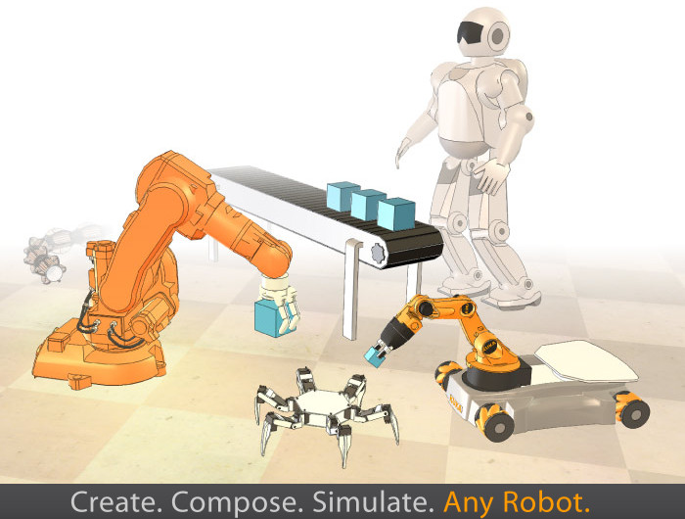

Control

Slide 19
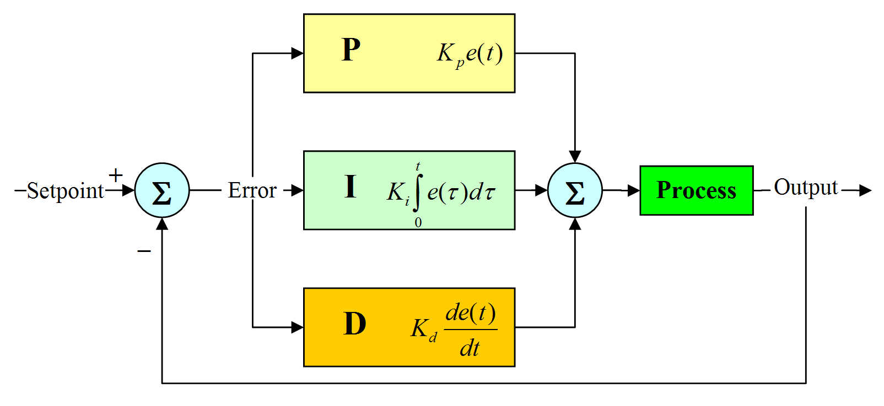
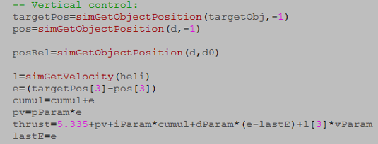
PID for altitude control

Slide 20
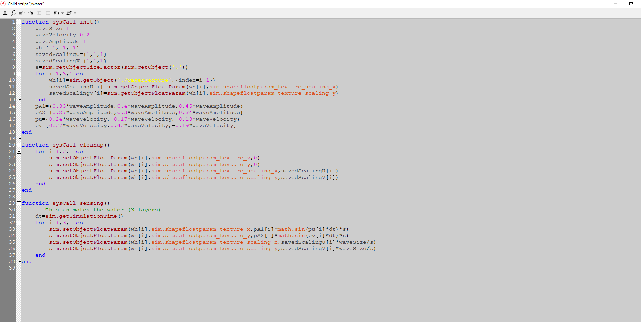

Slide 21
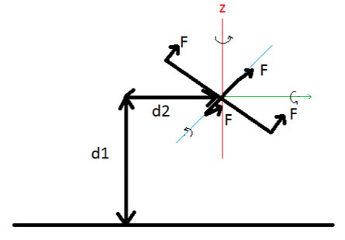
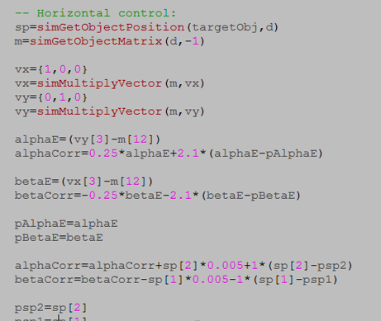
PID for horizontal velocity control

Slide 22
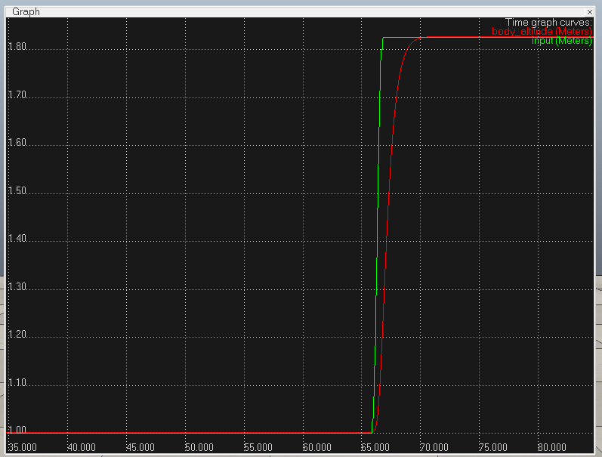
Responses
Altitude

Slide 23
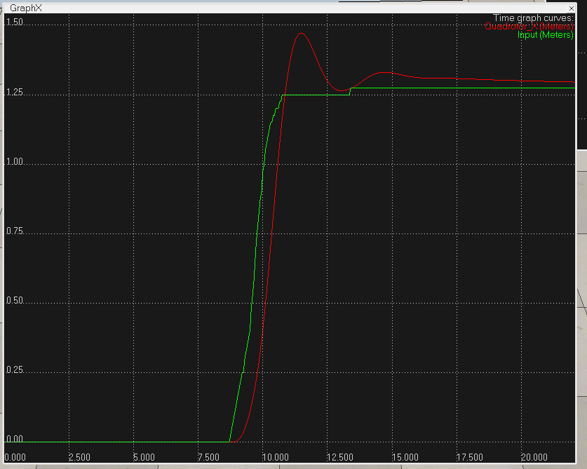
X Y

Slide 24
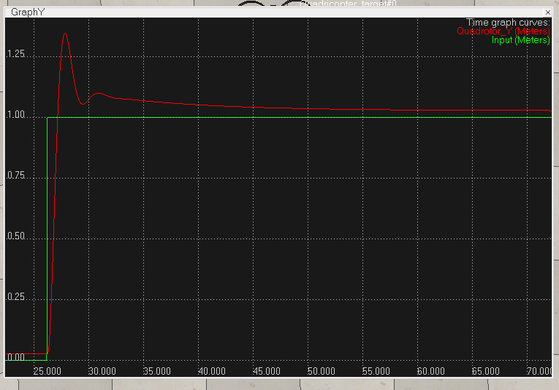
X
Y

Slide 25
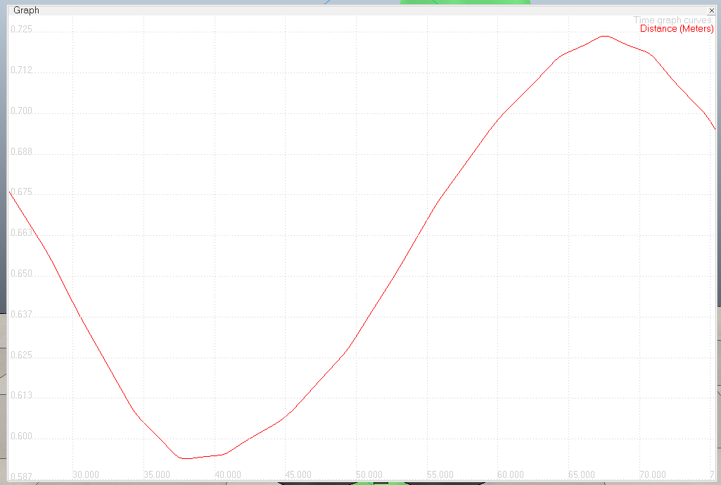
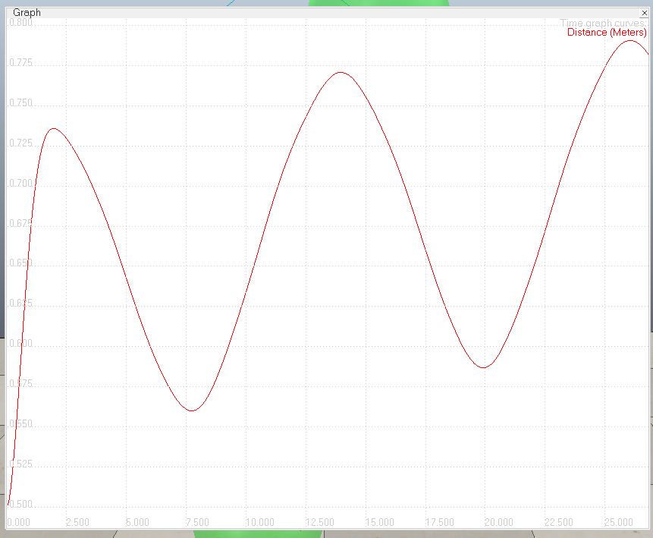
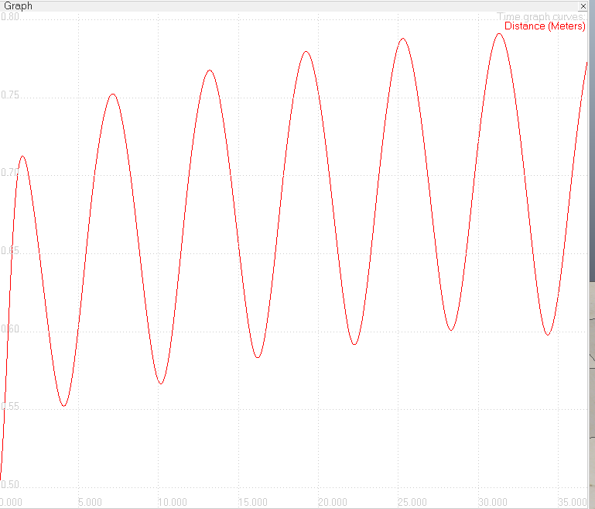
Path following results
High Period
Low Period
Medium Period

Slide 26
Thanks ☺
All files related to this project can be found in:
Https://github.Com/rahashabani/ee587-project

